Slide 1
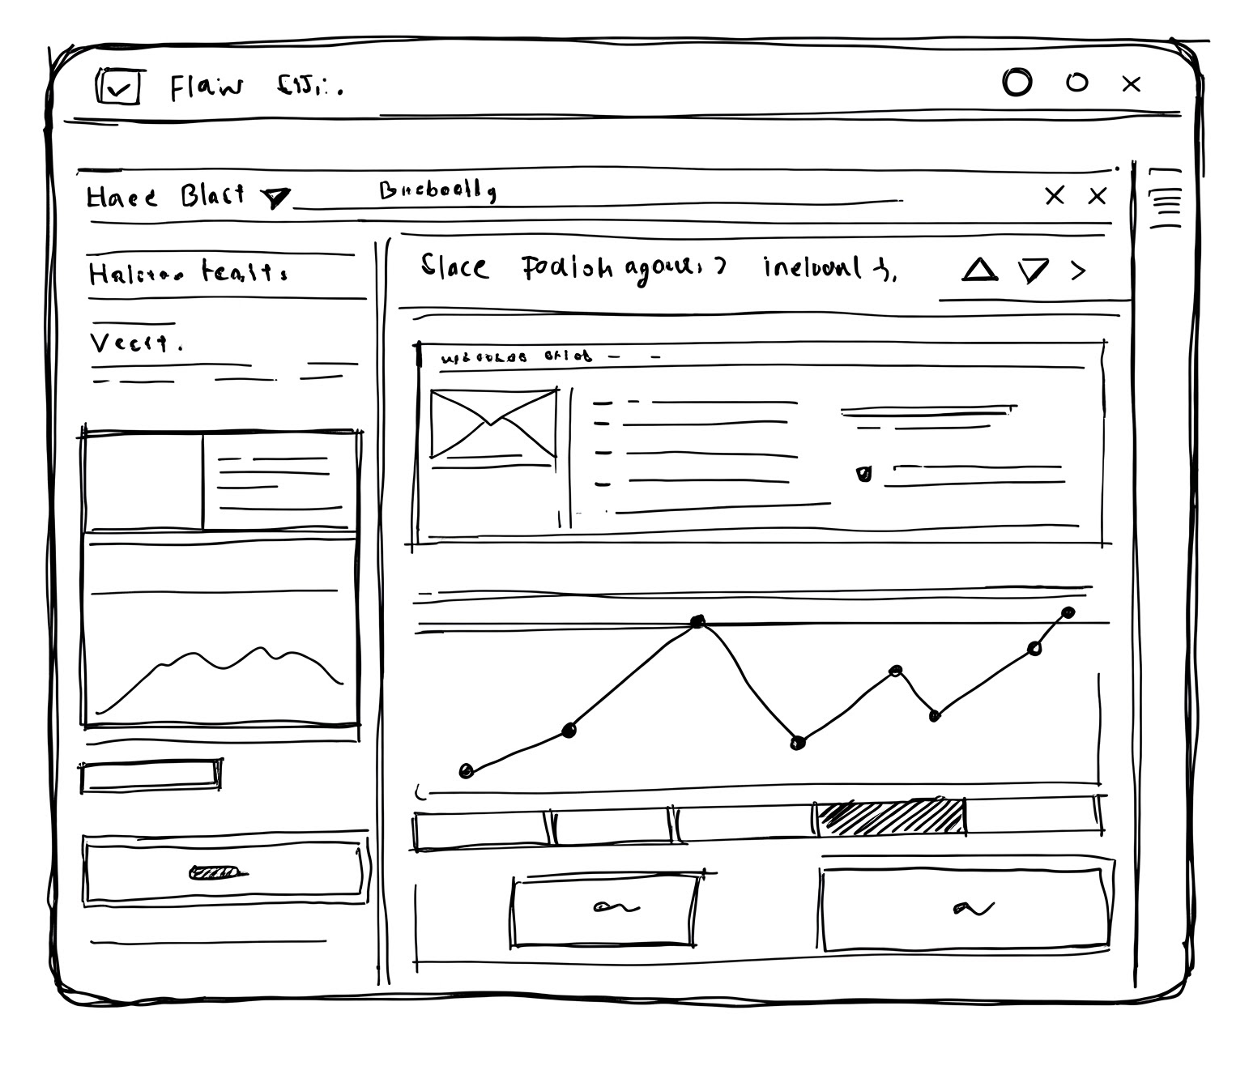
Use Case: AI-Powered Customer Personalization Platform for Retail

